Slide 1

"Financial Data Classification Using Machine Learning"
"Enhancing Customer Insights Through Predictive Analytics"
By- Khushi Painter

Slide 2
Introduction
What is Financial Data Classification?
It involves understanding customer financial behavior by analyzing their financial transactions, investments and demographics.
Using machine learning, we can identify patterns and predict customer revenue categories, helping businesses make informed decisions.
Why This Project is Important:
Targeting High-Value Customers: Helps businesses identify and prioritize high-revenue customers.
Improved Decision-Making: It improves efficiency and profits by using data insights.

Slide 3
About the Project
Project Overview:
This project focuses on predicting customer revenue categories using machine learning.
It uses financial, investment, and demographic data to group customers accurately.
Key Highlights:
Implements multiple machine learning models for accuracy.
Provides insights for better decision-making in financial services.

Slide 4
Problem Statement
Objective:
To predict customer revenue categories using financial and demographic data.
Significance:
Identify high-value customers for strategic marketing.
Helps reduce time and resource wastage by focusing on the right audience.

Slide 5
Data Overview
Dataset Summary:
Dimensions: [ 8124 rows & 32 columns]
Target Variable: 'Revenue.Grid' (Binary classification)
Feature Categories:
Demographics: status, children, gender, region, occupation, occupation_partner, home_status, family_income, age_band.
Financial Metrics: Average.Credit.Card.Transaction, Balance.Transfer, Term.Deposit, Portfolio.Balance, Average.A.C.Balance.
Investments: Investment.in.Equity, Investment.in.Mutual.Fund, Investment.Tax.Saving.Bond, Investment.in.Commudity, Investment.in.Derivative, Home.Loan.
Insurance: Life.Insurance, Medical.Insurance.
Other Details: year_last_moved, self_employed, self_employed_partner, TVarea, Online.Purchase.Amount, post_area, post_code.

Slide 6
Key Steps in Data Preprocessing "Enhancing Data Quality for Better Insights"

Slide 7
Preprocessing Workflow:
Data Loading: We have two datasets- train and test. The train dataset is loaded as fintrain, and the test dataset is loaded as finpredict.
Train-Test Split: Split the dataset into training (80%) and testing (20%) sets using train_test_split from sklearn.model_selection.
Source Column Addition:
Added a new column Source to identify the origin of data:
traindf: for training data
testdf: for testing data
finpredict: for prediction results
Combining Datasets:
i) Merged training, testing, and prediction datasets using pd.concat(). ii)Combined Dataset Shape: (10155 rows & 33 columns).
3) Drop Columns: Unnecessary columns are removed first. Specifically, 'REF_NO', 'post_code', and 'post_area' are dropped from the dataset.
4) Handling Unknowns: Converted unknown values to the mode of their respective columns to maintain consistency.

Slide 8
5. Outlier Detection and Treatment:
Interquartile Range (IQR) and Capping:
Interquartile Range (IQR):
Measures the spread of the middle 50% of the data.
Calculated as: IQR = Q3 - Q1.
Outliers are identified if they fall:
Below: Q1−1.5 × IQR
Above: Q3+1.5 × IQR
Capping:
Extreme outliers are replaced with upper or lower threshold values.
Lower Capping: Values below the lower bound are set to the lower limit.
Upper Capping: Values above the upper bound are set to the upper limit.
Maintains data integrity while reducing the influence of outliers.

Slide 9
6. Encoding:
Ordinal Encoding: Applied to 'age_band' and 'family_income'. To maintains the order of categorical, useful for features with a natural ranking.
Binary Encoding: Applied to 'gender' (Male = 1, Female = 2). To reduced dimensionality compared to one hot encoding, helping to minimize multicollinearity.
One-Hot Encoding: Applied to categorical features: 'status', 'occupation', 'occupation_partner', 'home_status', 'self_employed', 'self_employed_partner', 'TVarea', 'region'.

Slide 10
7. Feature Selection:
ANOVA F-test identifies important numerical features by evaluating their variance with the target variable, helping improve model performance.
Top 10 features selected using ANOVA: ['Average.Credit.Card.Transaction', 'Life.Insurance', ‘Average.A.C.Balance', 'Investment.in.Mutual.Fund', 'Investment.Tax.Saving.Bond', 'Online.Purchase.Amount', 'Investment.in.Commudity', 'Investment.in.Equity', 'Investment.in.Derivative', 'Portfolio.Balance''].
Recursive Feature Elimination (RFE) was applied using Logistic Regression to optimize the feature set. Recursively removes least important features, optimizing model performance and reducing overfitting.
Top 10 features selected using RFE: ['status_Widowed', 'occupation_Housewife', 'occupation_Student', 'occupation_partner_Housewife',
'occupation_partner_Student', ' home_status_Rent Privately', 'self_employed_Yes', 'TVarea_Grampian','region_Isle of Man', 'region_South West'].

Slide 11
Building and Evaluating Machine Learning Models "Building and optimizing the predictive model"

Slide 12
Models Evaluated:
Logistic Regression: A baseline linear model that provides insight and is well-suited for binary classification.
Support Vector Machine (SVM): Effective in handling complex decision boundaries.
K-Nearest Neighbors (KNN): A distance-based classification method that works well with non-linear relationships.
Decision Tree: A rule-based, transparent model that performs well with imbalanced data but is prone to overfitting.
Random Forest: An ensemble learning approach that combines multiple decision trees for improved accuracy and robustness.
Feature Selection Approach:
Comparison: All Features vs. RFE + ANOVA
Objective:
Identify the most relevant features to optimize model performance while reducing dimensionality.
Enhance computational efficiency and reduces the risk of overfitting.

Slide 13
Model Performance Evaluation
“Comparison of Different Models on Minority and Majority Classes”

Slide 14
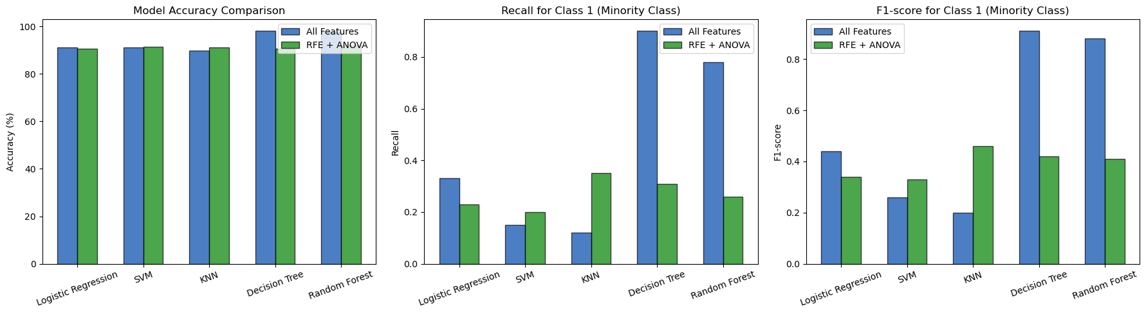
Performance Comparison for Minority Class (Class 1)
Model Performance on Minority Class
Content:
Model Accuracy Comparison
Recall for Class 1 (Minority Class)
F1-score for Class 1 (Minority Class)

Slide 15
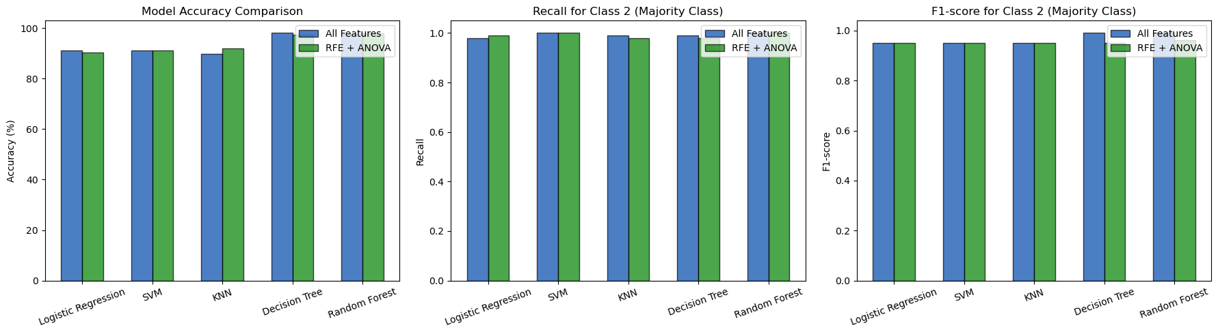
Performance Comparison for Majority Class (Class 2)
Model Performance on Majority Class
Content:
Model Accuracy Comparison
Recall for Class 2 (Majority Class)
F1-score for Class 2 (Majority Class)

Slide 16
Model Performance Summary
1. Accuracy Comparison
Accuracy is consistently high across all models, with Decision Tree and Random Forest achieving the highest (~98%).
KNN benefits the most from feature selection, showing an increase in accuracy.
Logistic Regression sees a slight drop in accuracy after feature selection.
2. Recall for Minority Class (Class 1)
Decision Tree and Random Forest (with all features) maintain strong recall (~87-90%), ensuring good identification of minority class cases.
KNN and SVM sees a improvement in recall after feature selection.
Logistic Regression shows a significant decline, indicating challenges in capturing minority class instances.
3. F1-score for Minority Class (Class 1)
Decision Tree and Random Forest (all features) achieve the best F1-scores, demonstrating balanced precision and recall.
KNN and SVM benefit from feature selection, slightly improving its F1-score.
Logistic Regression show reduced F1-scores after feature selection, reflecting a trade-off in classification performance.

Slide 17
4. Recall for Majority Class (Class 2)
All models perform consistently (~98-100%), effectively identifying the majority class.
No significant changes between all features vs. selected features.
5. F1-score for Majority Class (Class 2)
Nearly perfect scores (~98-100%) across all models, showing that the models handle the majority class well.
No substantial difference observed between feature selection techniques.
Key Takeaways:
Decision Tree & Random Forest outperform other models across all metrics.
KNN and SVM benefits the most from feature selection, improving its accuracy and F1-score.
Feature selection (RFE + ANOVA) helps reduce complexity while maintaining strong model performance.
Logistic Regression struggle to capture the minority class after feature selection, leading to lower recall and F1-scores.

Slide 18
Best Model For This Dataset "Random Forest emerged as the top-performing model"

Slide 19
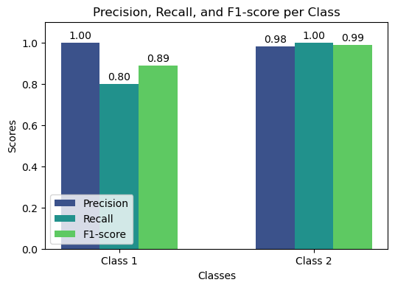
Random Forest: Best Performing Model
The Random Forest model performed exceptionally well with high accuracy, strong recall, and a balanced F1-score, ensuring reliable results.
Highest Accuracy: 98% overall performance.
Strong Recall for Both Classes:
Class 1 (Minority Class): 80% recall (captures most minority class cases).
Class 2 (Majority Class): 100% recall (perfect classification).
Best F1-score: Maintains a balance between precision and recall.

Slide 20
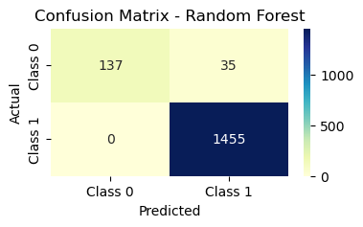
No Overfitting: Maintained high accuracy on both training (100%) and test (97.85%) data.
Confusion Matrix Insight:
Class 1: 137 correctly classified, 35 misclassified.
Class 2: 1455 correctly classified, 0 misclassified (perfect identification).
No Feature Selection Applied: The model performed best using all available features.

Slide 21
Thank You!

